Slide 1

“RANDOM GAINS” or “REAL GAINS”?
USING FALSE DISCOVERY RATE
TO UNCOVER MUTUAL FUND RETURNS .
“RANDOM GAINS” or “REAL GAINS”?
USING FALSE DISCOVERY RATE TO UNCOVER FUND
Project BY:-
Vaishnavi Andhare
Myur Patil
Arya Chudnaik
Suraj Kushwah
Koustubh Chaudhari
Project BY:-
Arya Chudnaik (A040)
Suraj Kushwah (A041)
Vaishnavi Andhare (A042)
Mayur Patil (A043)
Koustubh Chaudhari (A044)
Mentored by:-Prof. Mangesh Kutekar

Slide 2


THE MIRAGE ANALOGY
In the world of investments,
mutual funds often market themselves with promising returns, luring investors into a false sense of security. It's essential to scrutinize these claims and understand the underlying risks associated with high returns. Understanding the False Discovery Rate (FDR) is crucial
for investors.

Slide 3


Understanding
Mutual Funds
Mutual funds are investment vehicles that pool money from multiple investors to purchase securities. Evaluating their performance requires robust statistical methods to avoid misleading conclusions, particularly in the context of FDR.

Slide 4



FUND MANAGER EXPERTISE
Skilled managers have an impact
on fund performance through their
decision-making abilities how to write
it more creatively.
ROLE OF LUCK
Luck can cause short-term
fluctuations in performance,
especially during volatile market
conditions.

Slide 5


Project objective
The aim of this research project is to determine whether skill of the Fund manager or luck plays the most significant role in the Mutual funds market.

Slide 6

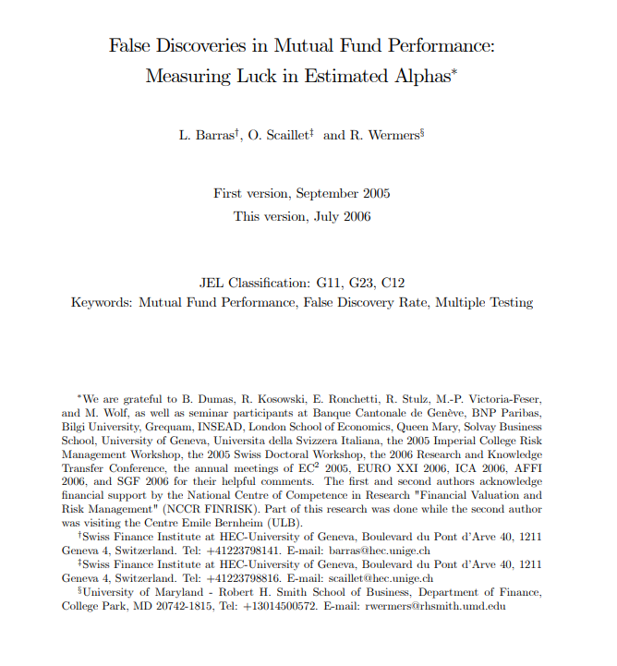
Research paper referred

Slide 7
Structure of the paper
Data collection and
Data Sorting
Performance evaluation of Mutual funds.
To study fund performance, it uses : Fama – French 3 factor model, Fama French Carhart 4 factor model
Using False DIscovery rate method, to study luck component.

Slide 8

Evaluating Performance Metrics
Key performance metrics such as alpha, is one of the essential for assessing mutual funds. Understanding how these metrics interact with FDR can improve decision-making and
investment strategies.
Data Description
• Monthly data of 77 funds from the year 2018 – 2022 (March) has been screened out from it.
• The data includes four variables
- SMB, HML, WML, MKT
• These factors are extracted from : Agarwalla, S. K., Jacob, J. and Varma, JR. ~ By IIM Ahmedabad

Slide 9
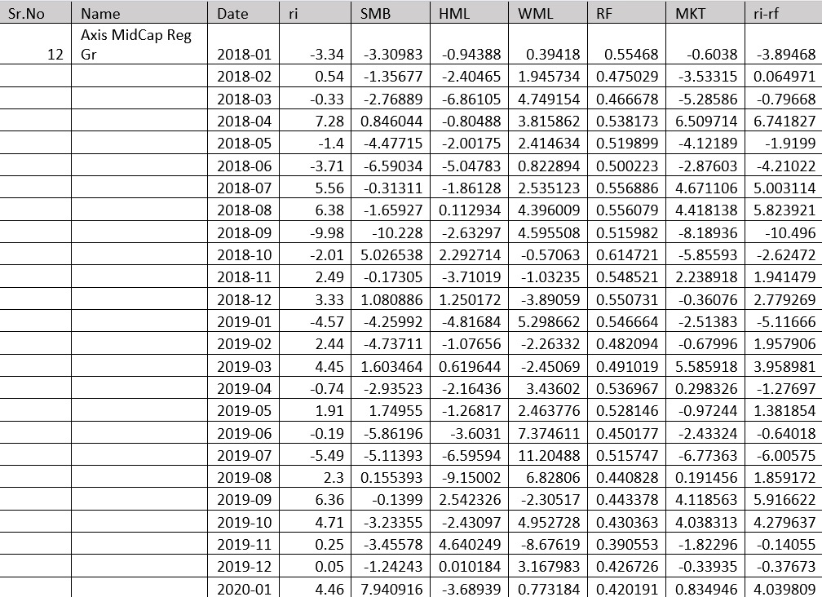
SMB (Small Minus Big): Size premium, return difference between small-cap and large-cap stocks.
HML (High Minus Low): Value premium, return difference between high and low book-to-market stocks.
WML (Winners Minus Losers): Momentum effect, comparing returns of past winners and losers.
RF: Risk-free rate of return.
MKT(rm-rf): Excess market return (market return minus risk-free rate).
ri-rf: Excess return of investment over risk-free rate.

Slide 10
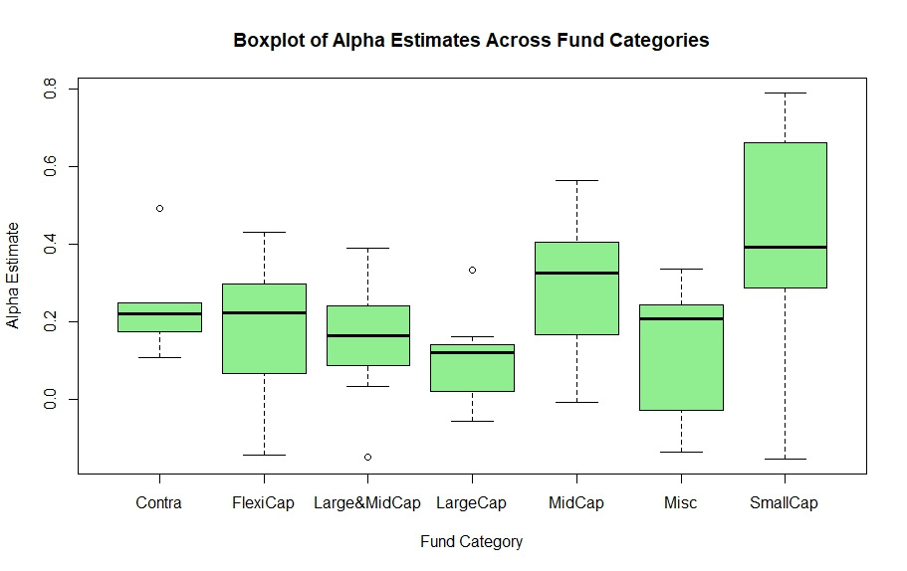
The distribution of alpha estimates varies considerably across fund categories, suggesting that fund performance can differ depending on the type of fund. Categories with higher median alpha values might be more skillful or simply luckier in terms of generating returns, while lower or tighter spreads around zero may indicate consistent, but less remarkable, performance.

Slide 11
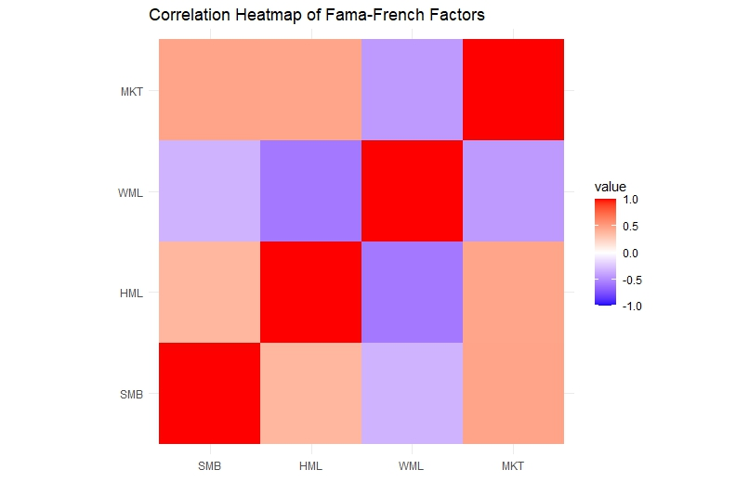
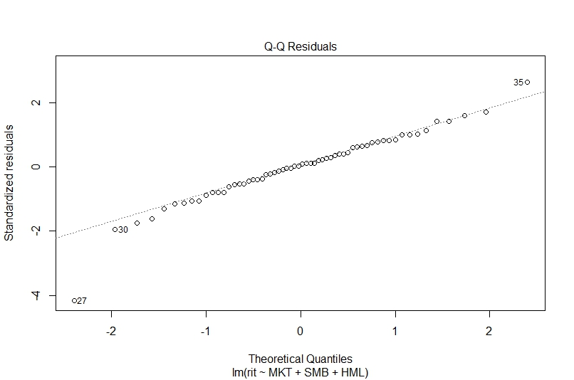
To Check Correlation Between the factors
To check Normality of the residuals (Q-Q plot)

Slide 12

Fama_French 3 Factor model
Eugene F. Fama and Kenneth R. French proposed Fama-French 3 factor model based on CAPM model in 1993.
According to thismodel,there are
three factors affecting thefund
performance,that are :
• • •
Market return (MKT) Securities scale (SMB) Book market value (HML)

Slide 13
It can be expressed as follows:
ri-rf= α + βi1*MKT + βi2*SMB + βi3*HML + ε
Where,
•
•
ri– return rate of securities assets
rf – risk free interest rate
•rm – return of market portfolio
•(rm - rf) - market risk premium
•rs– return rate of issuing security assets of small companies
•rb-return rate of issuing security assets of big companies
•rh – return rate of assets with high book value of security assets
•rl-return rate of assets with low book value of security assets
•ε - residual item
•α - excess return (measures skill of a manager)

Slide 14

Introduction to FDR
False Discovery Rate (FDR) is a crucial concept in statistical analysis, particularly in ﬁnance. This presentation will explore its signiﬁcance in evaluating mutual fund performance and understanding the implications of statistical errors in investment decisions.
FDR is the expected ratio of false positives (FP) to the total number of positive classifications (rejections of the null), which includes both false positives (FP) and true positives (TP).
FDR = False Positives
Total Positives

Slide 15


Fama-French-Carhart 4 factor model
FALSE DISCOVERY RATE METHOD SIMULATION STEPS:-
•
Hypothesis
$α_{i}=0 VS α_{i} ≠0$
where,all the coefficients are same as three- factor model, except for momentum factor.
The main change lies in the momentum factor,
which is obtained by subtracting the poor
performance of the previous period from the
current return level of the portfolio which
performed well in the previous period in the
market.
The four-factor model is more widely used in
measuring the level of excess return of
investment funds.
•
Conduct Multiple Hypothesis Tests
Perform t-tests on each hypothesis and obtain the p values
•
Calculate p-values
Calculate p-values and for each test.

Slide 16
Set Level of significance
α = 0.05.
Apply the Benjamini-Hochberg (BH) Procedure
Sort p-values in Ascending Order
Decide i(α) such that :
P(i) <= (i / m) * α
where i is the rank of the p-value and m is the total number of tests.

Slide 17
Decision criteria :
Reject H(i) if P(i) <=P(i α)
Compute FDR Metrics
Calculate the proportion of false discoveries among all declared significant tests
Output Results
Report significant findings

Slide 18
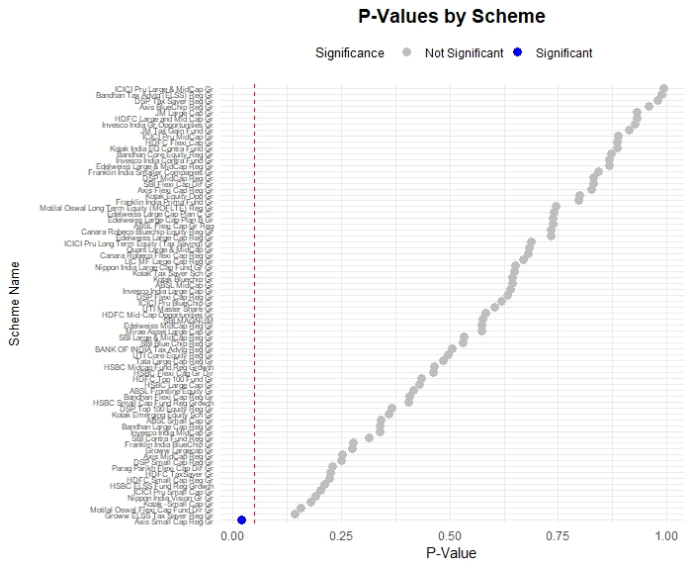

Slide 19
Fama-French-Carhart 4 factor model
•
The four-factor model was developed byMark M.Carhart in the year 1997.
According to this model, there are four factors affecting
fund performance, that are :
•
1.
Average return
2. 3. 4.
•
Securities scale Book market value Momentum factor
The model is as follows:
ri-rf= α + βi1*MKT + βi2*SMB + βi3*HML +βi4*WML + ε

Slide 20

Fama-French-Carhart 4 factor model
•
Where, all the coefficients are same as three- factor model, except for momentum factor.
The main change lies in the momentum factor,
which is obtained by subtracting the poor
performance of the previous period from the
current return level of the portfolio which
performed well in the previous period in the
market.
The four-factor model is more widely used in
measuring the level of excess return of
investment funds.
•
•

Slide 21
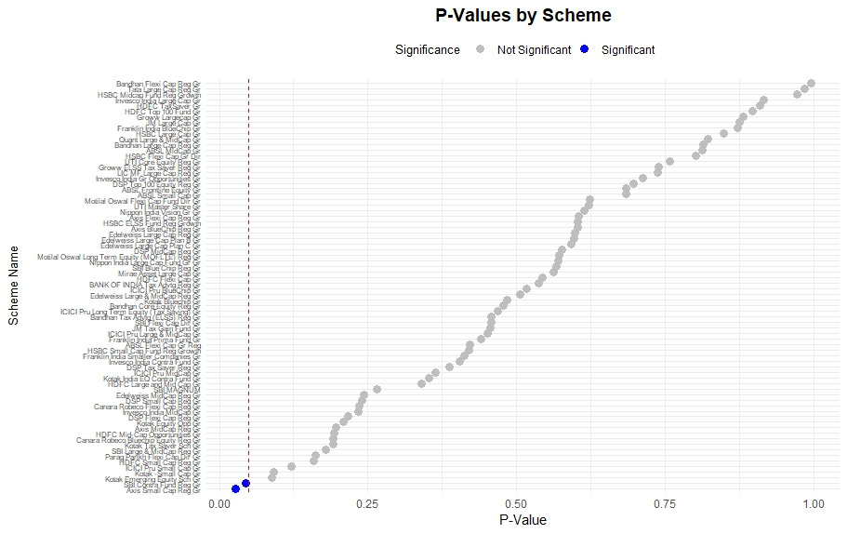

Slide 22


•
Based on our analysis of the collected data, our findings reveal that the performance of fund managers within the sampled funds demonstrates limited strength.
•
The positive excess returns observed appear to be driven more by chance than by the fund managers' investment selection skills.
•
On the other hand, negative returns cannot be solely attributed to bad luck; the skill (or lack thereof) of fund managers also appears to have an influence.

Slide 23
Limitations:-
Data Availability and Accessibility
Limited data sources: If only a few sources are available, it might reduce the comprehensiveness of the analysis.
Incomplete data: Missing data can lead to biases or gaps in the analysis.
Access restrictions: If data was confidential or access was limited, this could restrict what could be analyzed.
Sample Size and Representation
Small sample size: This can limit the generalizability and statistical power of your results.
Unrepresentative sample: If the data does not represent the target population accurately, the conclusions may not be widely applicable.

Slide 24


Future & Scope
Further Fund Analysis: Explore a broader range of funds, including different asset classes (equity, fixed income, real estate, etc.), to assess whether the influence of luck and skill varies across these categories.
Long-Term Performance: Investigate how the role of luck and skill in fund performance evolves over longer time frames, which can provide insights into the sustainability of good or poor performance.
Fund Manager Training: Fund managers can use these insights to refine their investment strategies and enhance their skills, potentially leading to improved long-term performance.
Global Comparison: Extend the research to a global scale, comparing fund performance across different regions, fund structures, and market conditions.

Slide 25
References:
False Discoveries in Mutual Fund Performance: Measuring Luck in Estimated Alphas∗ L. Barras† , O. Scaillet‡ and R. Wermers§ First version, September 2005 This version, July 2006.
Jun Gao, Niall O’Sullivan and Meadhbh Sherman Department of Economics (2021). “Chinese securities investment funds: the role of luck in performance”. Emerald Insight, 26, 1475-7702 https://www.emerald.com/insight/content/doi/10. 1108/RAF-07-2020-0182/full/html

Slide 26

MUTUAL FUND SAHI HAI ???

Slide 27

THANK YOU.

